Slide 1


SMART FLEET SELECTION: OPTIMIZING FOR SAFETY, SUSTAINABILITY, AND COST
Focusing on Core Constraints:
  Safety: Average fleet score => 3
  Diversity: Minimum one vessel for each of 8 fuel types.
  Logic: Minimize total risk-adjusted costs.
To achieve:
  A choice of fleets that came at the lowest cost after 7-step adjustment.
  Extra features
By Ctrl + Sea
NUS MARITIME HACKATHON 2026

Slide 2

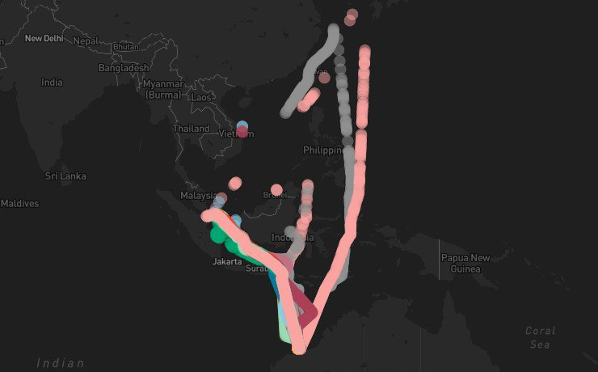
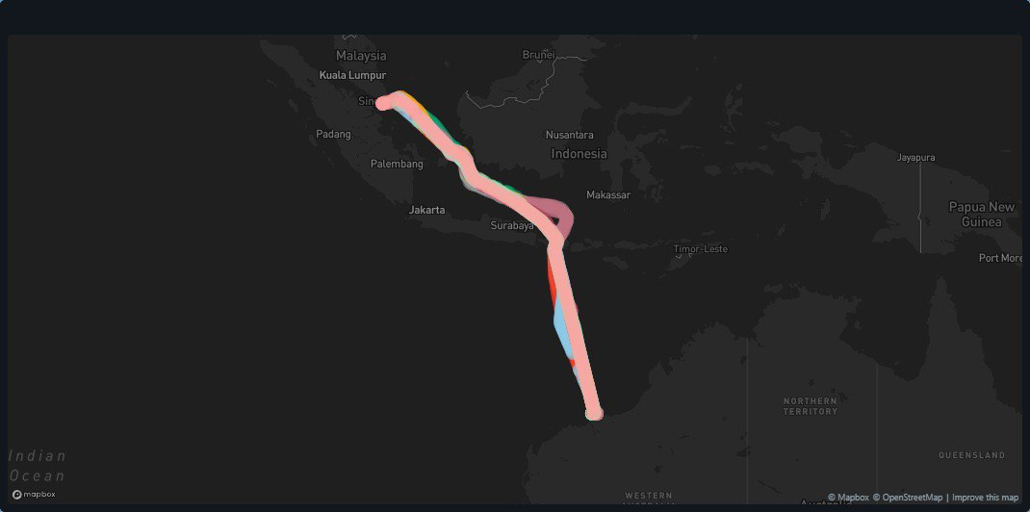
PROBLEM UNDERSTANDING & DATA ENGINEERING
  Data Cleaning: Eliminated operational outliers (voyages > 30 days) to reflect standard Singapore-Australia transits.
  Feature Engineering: Standardized Vessel IDs and developed new operational variables for Transit vs. Maneuvering modes.
  Geospatial Validation: Used AIS movement data to ensure selected fleets followed realistic and efficient routing patterns & to find activity data (A)
  Uniformity: Handled missing values with standardized placeholders to ensure model integrity across 108 vessels.
Data transformation of trip routes
By Ctrl + Sea
NUS MARITIME HACKATHON 2026

Slide 3


ARRIVING AT COST CALCULATION
Breaking it down into 3 main parts.
  Ship Ownership Cost
  Deadweight Tonnage (DWT): To determine base vessel price.
  Multiplier Factor (M): Technology-based price coefficient.
  Depreciation Rate (r): Fixed at 8%.
  Ship Lifespan (N): Fixed at $30 years.
  Salvage Value (S): $10% of ship cost (P).
  Capital Recovery Factor (CRF): Calculated ratio for amortization.
1. Fuel Cost
  Engine Power (P): Main, Auxiliary, and Boiler (kW).
  Baseline sfc: Standard efficiency rating (g/kWh).
  Design Speed (Vref): To calculate Maximum Speed (MS).
  Actual Speed (AS): To calculate Load Factor (LF).
  Lower Calorific Value (LCV): To adjust sfc by fuel type.
  Activity Hours (A): Voyage duration from timestamps.
  Emissions (CO_2 Equivalent)
  Total Fuel Mass: Calculated tonnes consumed.
  Emission Factors ($C_f$): Constants for CO2, CH_4, and N_2O.
  Global Warming Potential (GWP): Weights (1, 28, 265).
  Carbon Price: $80 USD per tonne $CO_2eq$.
4. Final Cost after Risk Premium
  Total Monthly Cost: Sum of Fuel + Emissions + Ownership.
  Safety Score: Rating (1–5) from dataset.
  Adjustment Rate: Percentage penalty/reward per score.
By Ctrl + Sea
NUS MARITIME HACKATHON 2026

Slide 4
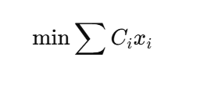
WORKFLOW:
MIXED-INTEGER LINEAR PROGRAMMING (MILP)
Why MILP?
  Solves conflicting constraints simultaneously
  Guarantees a global cost optimum, not heuristics
  Objective Function
  Minimise total adjusted fleet cost
IMPLEMENTATION
  Branch-and-bound solver (PuLP / SciPy)
  Rapid re-optimization for scenario testing
KEY CONSTRAINTS
  Capacity ≥ demand
  Linearised safety constraint (avg ≥ 3.0)
  Fuel diversity (all 8 fuel types represented)
  Binary vessel selection (1 voyage per vessel)
By Ctrl + Sea
NUS MARITIME HACKATHON 2026

Slide 5
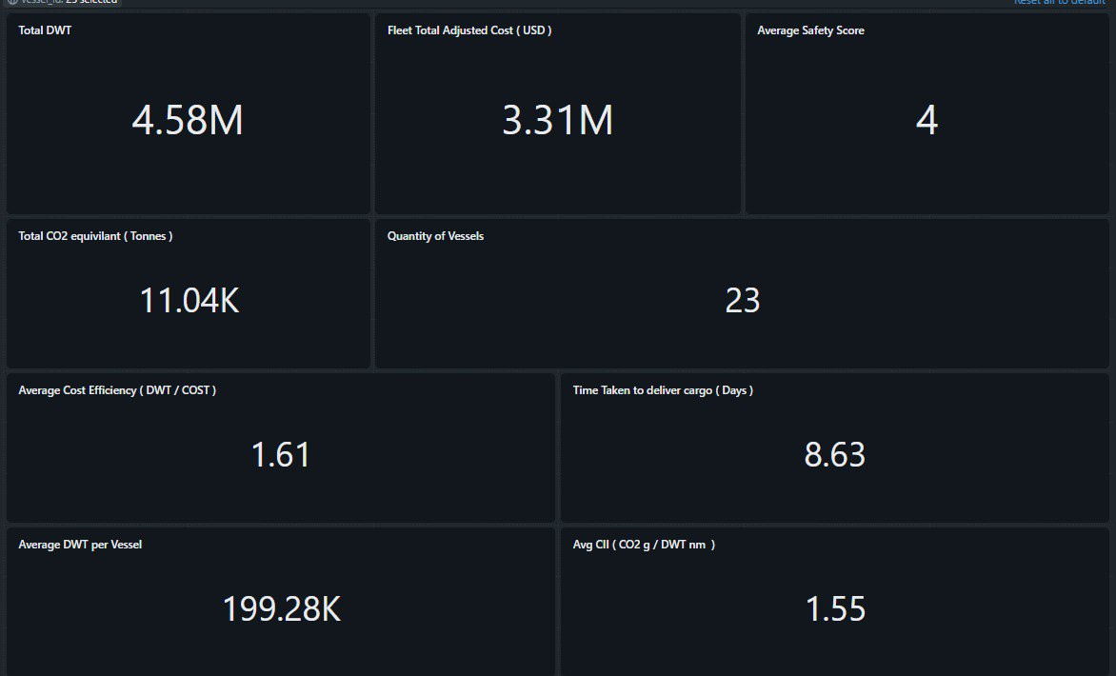
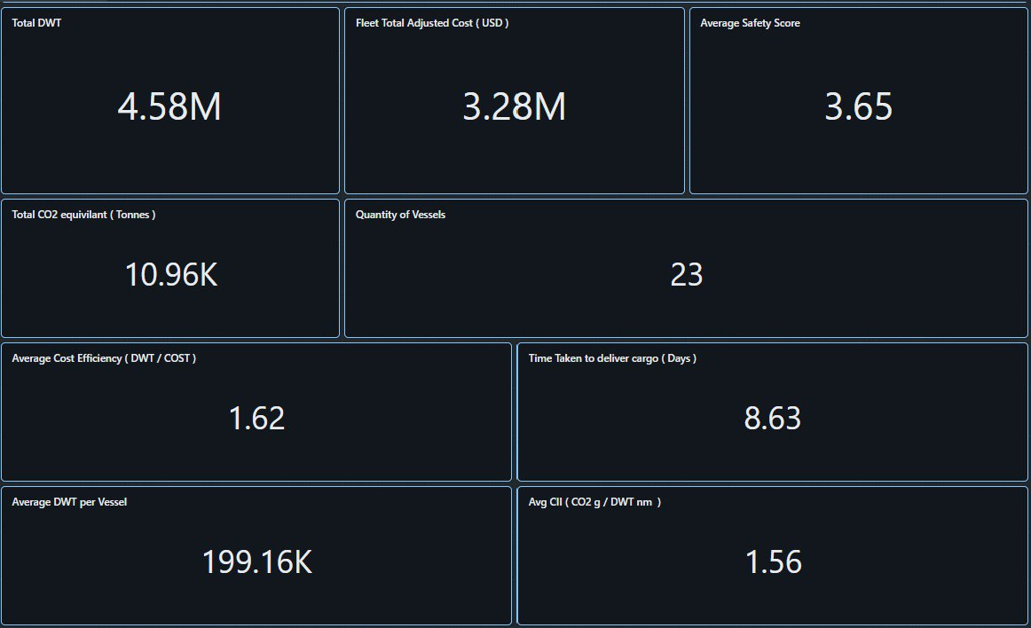
SENSITIVITY ANALYSIS COMPARISON
Given a change in safety constraint, how does cost change, and how does fleet selection change?
  Sensitivity Test: Increased average fleet safety constraint from 3.0 → 4.0
  Cost Impact: Higher safety scores receive stronger risk rewards, lowering costs for safer vessels.
COMPARING DIFFERENT SAFETY CONSTRANTS:
However:
  Fleet Shift: Stricter safety threshold forces selection of newer, higher-CAPEX vessels
  Exclusion Effect: Low-cost vessels with safety score = 3 become non-viable
  Key Insight: Higher safety standards introduce a “Safety Premium”, trading higher capital costs for reduced risk and insurance penaltie
By Ctrl + Sea
NUS MARITIME HACKATHON 2026

Slide 6
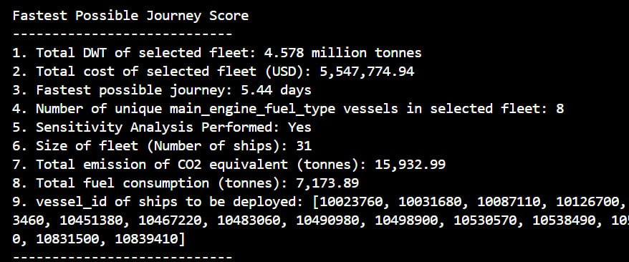
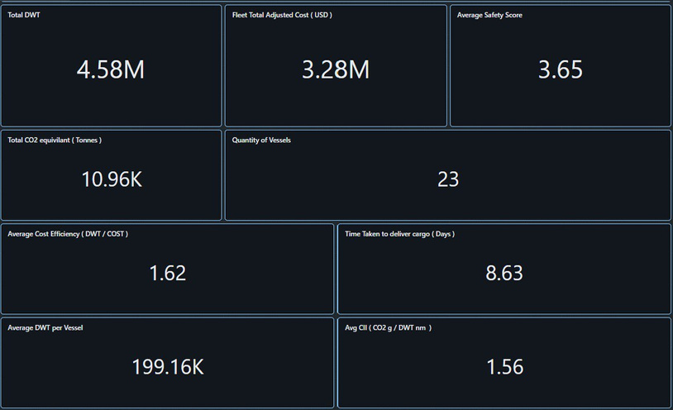
SOLUTION + EXTRA FEATURES
The IMO rates vessels on an A to E scale, where 'A' is major superior and 'E' is inferior. The required CII reduction factors become increasingly strict each year through 2030.
A CII of $1.56 g CO₂/DWT-nm for a fleet with an average DWT of nearly $200,000 (typical of VLCC or large LR2 tankers) is exceptionally low, considering that typical global tanker CII averages: ~2.6–4.0 g CO₂/DWT-nm
CARBON INTENSITY INDICATOR
By Ctrl + Sea
NUS MARITIME HACKATHON 2026

Slide 7
THANK
YOU !
Shadid Zarraf Rahman
Travis Ang Zhi Yan
Low Dong Xuan
Tayzar Toe Wai
By Ctrl + Sea
NUS MARITIME HACKATHON 2026

